Slide 1
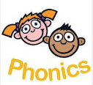
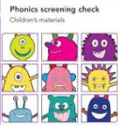

Phonics in KS1

Slide 2
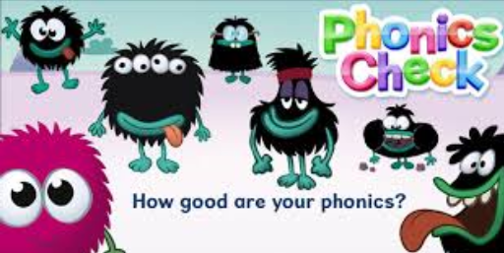
When is the phonic screening?
Who will complete the screening?
Nationally , all children in year 1 will have a phonics screening in June.
Children in year 2 who did not meet the standard in year 1 will also do the screening check.
Phonic screening check will normally be administered mid June.
Class teachers will administer the phonics check.

Slide 3
What is the phonic screening?
Children will be asked to read 40 words aloud.
Administered on a one to one basis.
Children may have met some of the words before, others will be new words.
The check will contain a mixture of real words and ’non words’ (or alien words).
Children will be told that they will be reading non words.
Non words cannot be read using memory or vocabulary, phonic knowledge has to be used.

Slide 4
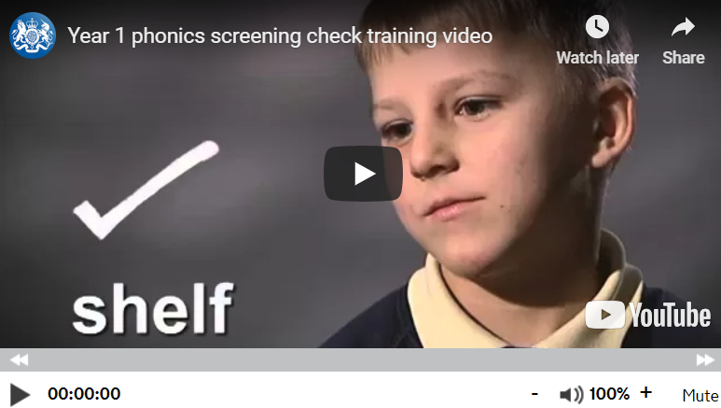
An example of phonic screening
https://youtu.be/IPJ_ZEBh1Bk

Slide 5
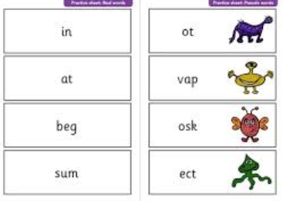
What does the screening material look like?
The test is a booklet containing 40 words.
It is divided into two sections.
Each section contains real and non words.
Each page has 4 words on it.
Children can Fred talk/ sound out each word.
They then blend the sounds together to read the word.
They can do this aloud or quietly.
Each non word also called an alien word is accompanied by a picture of an imaginary creature.

Slide 6
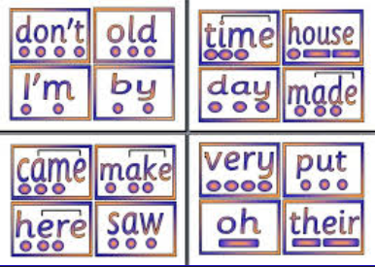
What happens in the test?
Children will read in a quiet area with their class teacher.
The are allowed to sound out or Fred talk and blend sounds if they need to before reading the words.
Children are allowed to add sound buttons or dots and dashes to words while reading if they want to.

Slide 7

Helping at home
Individual reading
Free choice reading
Word reading activities
Making up non words
Phonics games
Reading high frequency words
https://www.gov.uk/government/publications/phonics-screening-check-sample-materials-and-training-video

Slide 8
After the phonic screening
All results will be sent to the local authority by the end of June.
Parents will be informed of children’s results with their end of year school report.
If your child does not meet the standard this year they will continue to be supported in phonics in year 2 and will be able to repeat the phonics screening in Year 2.

Slide 9
Any Questions

